Slide 1
Forecasting Poultry Drivers – Intern Project
Presenter: Jenny Lu
Mentor: Anh Tran

Slide 2
Project Overview
Goal
Predicting future monthly wholesale price for 3 target chicken drivers: breasts, leg quarters, and wings.
Why
Contributes to predicting Tyson’s annual operating revenue for poultry
Helps Tyson with budget planning, and supply/demand planning for poultry.
Approach
Focus on solely one driver first - chicken breast, and build a good forecasting model on it. Then do the same for the other two.

Slide 3
Timeline
Phase | Duration | Overview
Phase 1 | 6 weeks | 6-hour long YouTube video covering foundation concepts and standard practice
Phase 2 | 1 week | EDA on chicken breast data
Phase 3 | 1 week | Triple Exponential Smoothing & Baseline SARIMA models
Phase 4 | 4 weeks | SARIMAX models with 4 different exogenous variables
Phase 5 | 1 week | Wrapping up, presentation & final thoughts

Slide 4
Major Technical Concepts
Data preparation:
Import the dataset with monthly chicken prices from 2001 - 2026
Clean out NA rows , convert time series date column into date type and set the date column as index
Understanding data:
Seasonality: monthly plot, quarterly plot, seasonal decomposition
ACF & PACF Autocorrelation Graphs
Stationarity: Augmented Dickey-Fuller (ADF) Test
Models Used:
Triple Exponential Smoothing
SARIMA
SARIMAX with different exogenous variables
Other Poultry Drivers: Chicken Wings and Leg Quarters
Bird Flu Data
Economic Factors from Federal Reserve (FRED)
Slaughter Data
Slaughter Data + Economic Factors

Slide 5
Forecasting Workflow
Chicken Breast Data time series:
01/01/2001 – 02/01/2026
Test period: 12 months
Training set: 01/01/2001 – 02/01/2025
Testing set: 03/01/2026 – 02/01/2026
Workflow:
Apply the model to the training set, fit the model, build predictions from the model and compare it to the test set.
Performance metrics:
Mean Absolute Error (MAE)
Root Mean Square Error (RMSE)
Mean Absolute Percentage Error (MAPE)

Slide 6
Model Comparison
Model | MAPE | MAE | RMSE
Triple Exponential Smoothing | 20.15% | 32.30 | 35.38
SARIMA | 15.33% | 28.51 | 34.56
SARIMAX w/ Economic Factors | 15.81% | 27.34 | 31.06
SARIMAX w/ Slaughter Data | 15.06% | 28.72 | 36.53
SARIMAX w/ Slaughter Data + Economic Factors | 17.67% | 29.51 | 33.51

Slide 7
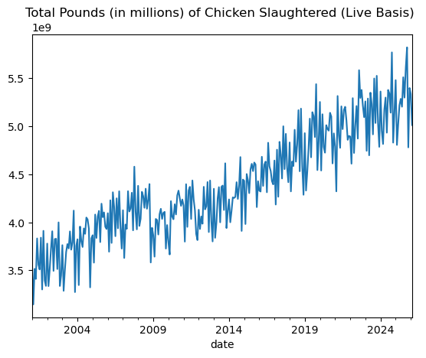
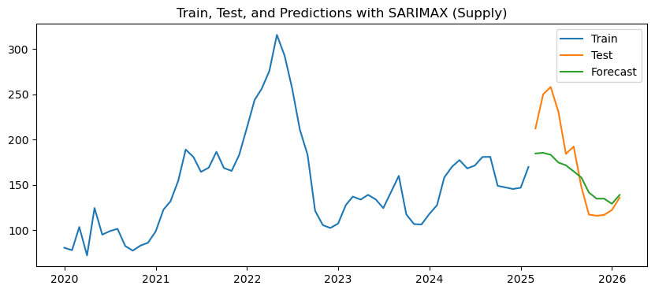
SARIMAX w/ Slaughter Data
Queried from https://quickstats.nass.usda.gov/

Slide 8
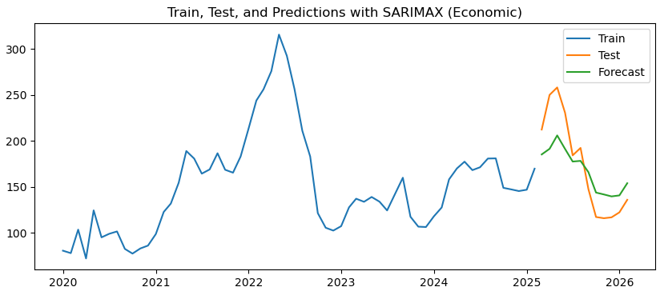
SARIMAX w/ Economic Factors
Economic Factors Include:
US Corn Prices, Soybean Prices, Heating Oil Prices, Unemployment Rate, Consumer Sentiment Index, Consumer Price Index, Beef Price

Slide 9
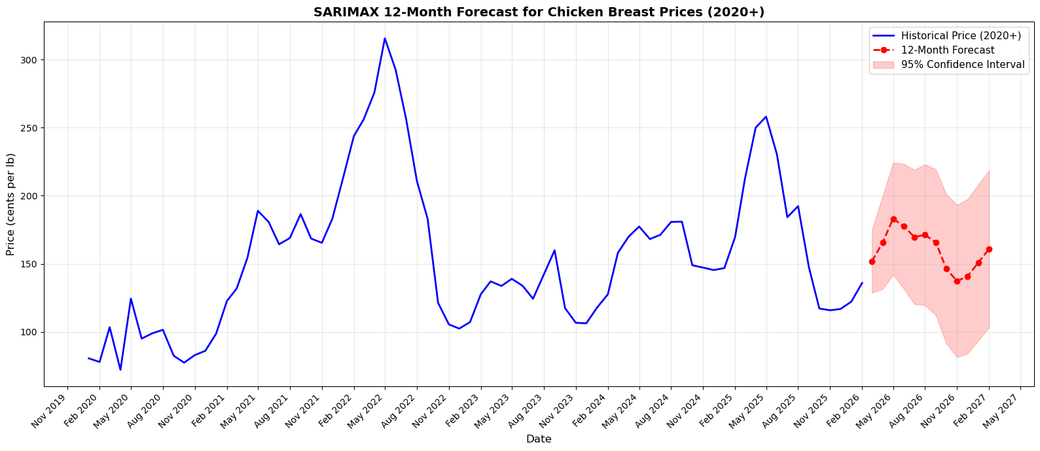
12-month forecast using SARIMAX with Economic Factors

Slide 10
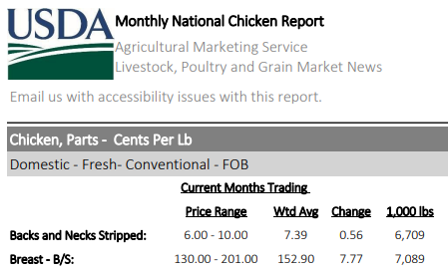
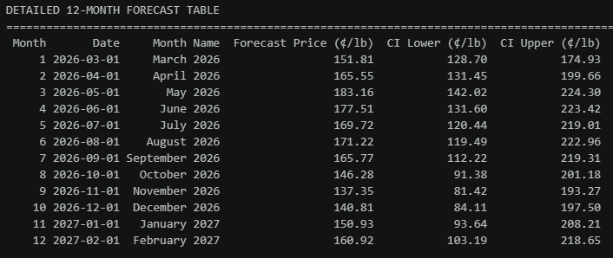
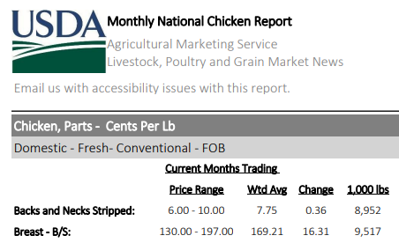
March 2026
Prediction vs Actual Chicken Breast Price (cents/lb.)
Forecast
April 2026

Slide 11
What I learned
From the project:
Researching and looking for the right data takes a lot of time. Data needs to be valid, relevant, and populated enough to align with the target variable time series
Assumptions need to be backed with data.
It’s important to understand why I do things certain ways and also understand the math behind the techniques used.
Domain knowledge on what impacts chicken price, such as bird flu, heating oil price, beef/pork price, feed costs, seasonal holidays, etc.
Overall:
I learned that Data Scientist is not a role I want to pursue long-term because it is too technically rigorous.
I believe my strengths lie in roles that requires skills such as management, communication and problem solving and strategy.
I am still interested in technology tools very much and would like to continue learning and staying on top of the trend.

Slide 12

What’s next?
This summer, I will learn about:
System Design
Foundational knowledge on APIs, data pipelines, databases
AI workflows and AI agents
Build a fun project to solidify these skills. Apply the framework that product owners use
Research, ensuring product is a market fit, building product roadmap, PRD document with user needs, features, success metrics, etc.
Next step: Master’s Degree in Economic Data Analytics
Become a Graduate Assistant to have tuition funded for + monthly stipend
Simultaneously working part-time internship at Tyson
Graduate with a Masters Degree and 3 years of working experience

